Slide 1


Task 2: PREDICTIVE ANALYSIS Decision Trees, Random Forests, advanced Regression (lasso or ridge)

Slide 2
Welcome to D209 – Data Mining 1!
Welcome to D209 – Data Mining 1! We are glad you are here. You are now in the Data Mining phase of the Data Analytics Lifecycle. On starting the course, follow the study plan below:
Download and review the “One Page Course Overview” from the Course Chatter.
Most of you aim to complete the course in 2-4 weeks.
In your Data Camp custom track, Courses 1, 5 & 7 are in Python, 2, 3, 4 & 6 are in R.
Watch the DataCamp videos. Use your student WGU email after clicking on video links and use SSO as needed.
Review the two tasks to determine a roadmap for the course.
Define your research question and the goals of your data analysis.
Determine the appropriate tool for the task (Python or R).
Select your data set from the “Data Sets and Associated Data Dictionaries” link in the introductory paragraph of the task.
Attend the Cohort Webinar that holds the 2nd Sunday of every month. Time: 2:00 pm MDT, 3:00 pm CST, or 4:00 pm EST. https://wgu.webex.com/wgu/k2/j.php?MTID=tec3de85d33283f764cc2049a269827b4
If asked:
Session Number: 2624 239 7414
Session Password: D209

Slide 3
Task 2: Create a data mining report using predictive and data mining models.
Implement predictive data mining models using Decision Trees, Random Forests, or advanced Regression (i.e., lasso or ridge).
Prediction is used when the output is numerical rather than categorical. Continuous numerical data do not have a set value range, e.g., time series data.
Prefer to predict a numeric variable with Random Forest Regressor, not Random Forest Classifier.
Evaluate data mining model performance for precision and accuracy.
Analyze, summarize, and discuss the implication of your work.
Write the report of your analysis and do a Panopto video recording of your report.
Submit all necessary documents.
Schedule a time with your CI if you need help. We wish you success and a great learning experience!

Slide 4
Learning Resource
This course uses DataCamp as the primary learning resource.
To prepare for the performance assessment, it is recommended that you complete all the DataCamp courses within the Data Mining I track.
This course consists of seven DataCamp courses comprising 29 hours of content:
Supervised Learning with scikit-learn – Python (4 hours)
Machine Learning with Tree-Based Models in Python (5 hours)
Model Validation in Python (4 hours)
Supervised Learning in R: Classification (4 hours)
Supervised Learning in R: Regression (4 hours)
Machine Learning with caret in R (4 hours)
Tree-Based Modules in R (4 hours)

Slide 5
Resource Library
All are hyperlinked on the resource library page.
Cheat Sheets
DataCamp (n.d.) Python for data science cheat sheet. DataCamp.
R Studio (n.d.) RStudio cheatsheets. R Studio.
Books
BRUCE, P. A. (2020). Practical statistics for data scientists. 50+ essential concepts using r and python.
O'Reilly Media, Incorporated. Retrieved from WGU Library.
Larose, C. D., & Larose, D. T. (2019). Data science using Python and R. Chichester, NJ: Wiley Blackwell.
Websites
VideosInformation Builders. (n.d.). Welcome to the WebFOCUS release 8 technical library.
Navlani, A. (2018, December 4). Naive Bayes classification using Scikit-learn. DataCamp. https://www.datacamp.com/tutorial/naive-bayes-scikit-learn
STHDA. (n.d.). Factoextra R Package: Easy multivariate data analyses and elegant visualization.
Jedamski, D. (2019). Applied machine learning: algorithms. LinkedIn Learning.
Kolalapudi, S. (2017). Classification using tree-based models. PluralSight.
Poulson, B. (2020). R essential training part 2: modeling data. LinkedIn Learning.
Pierson, L. (2019). Python for data science essential training part 2. LinkedIn Learning.

Slide 6
Need to study R Syntax?
On the D209 Homepage, click on “GO TO COURSE MATERIAL.”
Under catalog, click on tracks, then Custom Tracks.
You will see an “R Programmer” course. https://app.datacamp.com/learn/career-tracks/r-programmer
Intermediate R courses at https://app.datacamp.com/learn/custom-tracks/custom-r-prep-work
Textbooks
Data Science Using Python and R
A textbook used in D206, provides good supplemental content for this course. Helpful content:
• Chapter 6 Decision Trees & Random Forests
• Chapter 7 Model Evaluation
• Chapter 8 Naive Bayes
Practical Statistics for Data Scientists
Helpful content:
• Chapter 4: Regression and Prediction
• Chapter 5: Classification
• Chapter 6: Statistical Machine Learning

Slide 7
Additional Resources with Data Preparation
Often with data mining/ML models, it is important to do various preprocessing of data
(Techniques: missing data, standardizations, PCA, binding, one-hot encoding, etc.).
Additional resources you might find beneficial in prepping your data for analysis.
Bowne-Anderson, H. (2016). Preprocessing in Data Science (Part 1): Centering, Scaling, and KNN. DataCamp.
Bowne-Anderson, H. (2016). Preprocessing in Data Science (Part 2): Centering, Scaling and Logistic
Regression. DataCamp.
Bowne-Anderson, H. (2016). Preprocessing in Data Science (Part 3): Scaling Synthesized Data. DataCamp.
Brownlee, J. (2016). Get your data ready for machine learning in R with pre-processing. Machine Learning Mastery.
Kumar, D. (2018). Introduction to data preprocessing in machine learning. Towards Data Science.
Shimanto, H. (n.d.). Data preprocessing: Getting started with machine learning.
Analytics India Mag (2019). Data preprocessing with R: Hands-on tutorial. Analytics India Magazine.

Slide 8
Competencies
Predictive Data Mining Models
The learner implements prediction data mining models to find hard-to-spot relationships among variables.
Data Mining Model Performance
The learner evaluates data mining model performance for precision, accuracy, and model comparison.

Slide 9
Introduction
In this task, you will create a data mining report. In doing so, you must select one of the data dictionary and data set files to use for your report from the following link: Data Sets and Associated Data Dictionaries.
You will use Python or R to analyze the given data and create a data mining report in a word processor (e.g., Microsoft Word). Throughout the submission, you must visually represent each step of your work and the findings of your data analysis.
To achieve that objective:
Implement predictive data mining models using Decision Trees, Random Forests, or advanced Regression (i.e., lasso or ridge).
Evaluate data mining model performance for precision and accuracy.
Analyze, summarize, and discuss the implication of your work.
Write the report of your analysis and do a Panopto video recording of your report.
Submit all necessary documents.

Slide 10
Python or R Environments
Python Environments in Anaconda. Please see my video on how to install and update Anaconda in the Announcement and Course Tips.
Jupyter Notebooks are based on JSON files. The Jupyter Notebook is the original web application for creating and sharing computational documents. It offers a simple, streamlined, document-centric experience. My preference for this assignment.
Jupyter Lab is the latest web-based interactive development environment for notebooks, code, and data. Its flexible interface allows users to configure and arrange workflows in data science.
https://jupyter.org/

Slide 11
Python or R Environments
Select among R Script, R Notebook, and R Markdown
RStudio is a convenient interface or platform for programming in R.
R Script in my opinion is the actual programming language. Because it is a text file containing the same commands that you would enter on the command line of R. R script can be compiled into a report that includes commentary, source code, and script output formats including HTML, PDF, MS Word, and Markdown.
R Markdown is a specific type of file format designed to produce documents that include both code and text. This is my preference for this assignment so you can submit both your report and the code in one rich document.
R Notebook is a way to work with R Markdown files. Not designed for all types of work e.g., building a shiny app.

Slide 12
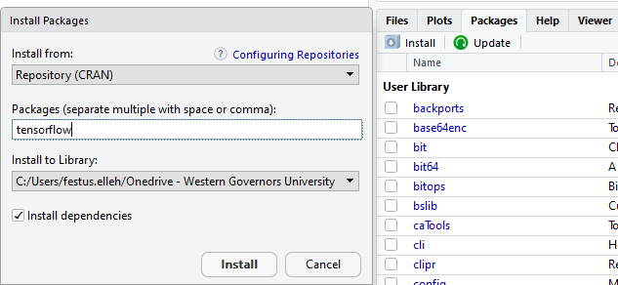
INSTALLING PACKAGES IN R
Click on ‘Install’ Under the “Files, Plots, Packages, Help, Viewer” pane.
Type in ‘TensorFlow’ in the “Packages” textbox as shown above.
Click “Install”
R will install TensorFlow.
Then, in the Source code pane, call the TensorFlow package by typing
library(tensorflow) and run.
Done!

Slide 13



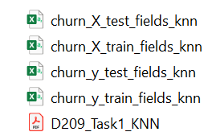
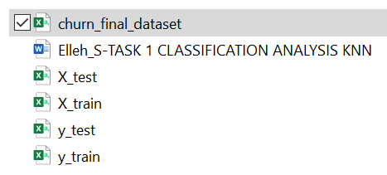
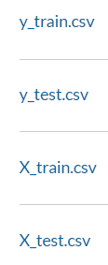

Cleaned Files

Slide 14
VISUALIZATIONS
Task 2 - Visualizations
During EDA
View the data – for example, histogram
Other Visualizations
C3 Correlation in data – Heatmap
D2 Graph of your model
E1 MSE, RMSE, R2 – table or graph

Slide 15
REQUIREMENTS
Part I: Research Question
A. 1. Propose one question relevant to a real-world organizational situation that you will answer using one of the following prediction methods: decision trees, random forests, advanced regression (i.e., lasso or ridge).
A. 2. Define one goal of the data analysis. Ensure that your goal is reasonable within the scope of the scenario and is represented in the available data.
Example Research Question:
Is it possible to predict the tenure of a customer and identify key contributors using the random forests methods based on the available data?
Example - Goals
The primary goal is to develop a random forests machine learning model to help the company predict its customers' tenure.
Identify key contributors/features causing customer churn EDA.
Recommend a course of action based on the results and implications of the analysis.

Slide 16
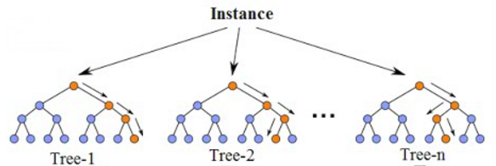
Part II: Method Justification
B. Explain the reasons for your chosen prediction method (DT, RF, or RG) from part A1 by doing the following.
B1. Explain how the prediction method you chose analyzes the selected data set. Include expected outcomes.
Random forests (RF)
Random forests are an ensemble learning method for classification and regression. It constructs multiple decision trees at the training time and outputs the mean of the predictions for regression. Each of the trees makes its own individual prediction. These predictions are then averaged to produce a single result.
Rationale: The averaging makes a Random Forest better than a single decision tree, improving its accuracy and reducing overfitting. A prediction from the Random Forest Regressor is an average of the trees' predictions in the forest. You can use the Scikit-learn library of Python to build the random forest model and the GridSearchCV() class to perform hyperparameter tuning.

Slide 17
B1 Cont’d
Decision tree
A decision tree is a machine learning algorithm that can handle both categorical and numerical data, requires less computation time, training time, not sensitive to the outlier, and is nonparametric. Thus, the decision tree will be a good fit for my dataset.
"According to Sehra (2020), a decision tree breaks down the data set into smaller subsets of instances with similar values (homogenous) like a flowchart diagram. Each subset has a leaf node and decision node. Each node represents features, and each branch represents a decision rule (test outcome).
There are two or three branches or sub-tree on a decision node. A terminal leaf node is the end of the algorithm, representing a final decision(outcome). The topmost decision node is called the root node, meaning the best predictor.

Slide 18
B1 Cont’d: Lasso Regression example. - works well when a few predictors actually influence the response
Lasso is a regression analysis method that performs both variable selection and regularization in order to enhance the prediction accuracy and interpretability of the resulting statistical model. The word “LASSO” stands for Least Absolute Shrinkage and Selection Operator. Lasso is meant to take a series of features and identify those most likely to have an impact on the prediction. If there is little to no impact, the feature is ignored. The Lasso regression is chosen because it will automatically remove features that do not have much impact on the model. It works well when there is a large set of features to choose from, but not all of them will influence the prediction. All the features are continuous numerical values.
B1 Cont’d: Using Ridge Regression example. Works well when most predictors impact the response.
Ridge regression is a method of estimating the coefficients of multiple-regression models in scenarios where linearly independent variables are highly correlated. Ridge regression is a model-tuning method that is used to analyze any data that suffers from multicollinearity. This method performs L2 regularization. When the issue of multicollinearity occurs, least-squares are unbiased, and variances are large, this results in predicted values being far away from the actual values.
https://www.mygreatlearning.com/blog/what-is-ridge-regression/

Slide 19
B2. Summarize one assumption of the chosen prediction method.
Random Forest Example:
The random forest uses bootstrap aggregation, and it assumes that sampling is representative, which is also an assumption of the decision tree on which the random forest is built. The tree-based model depends heavily on the training dataset used to build the model. For example, if one class consist of two components and in our dataset one component is represented by 100 samples, and another component is represented by 1 sample - probably most individual decision trees will see only the first component, and Random Forest will misclassify the second one (StackExchange, n.d).
Decision Tree Example:
According to Navlani (2018), one assumption of the decision tree algorithm is that it is a non-parametric. It doesn't make distribution assumptions on the data. Thus, decisions can deal with non-linear data, skewed data, multi-modal data, and categorical, ordinal, and non-ordinal data efficiently. This characteristic makes the model easier to understand, interpret, and visualize.
Ridge Regression Example
The assumptions of ridge regression are the same as that of linear regression: linearity, constant variance, and independence. However, as ridge regression does not provide confidence limits, the distribution of errors to be normal need not be assumed.

Slide 20
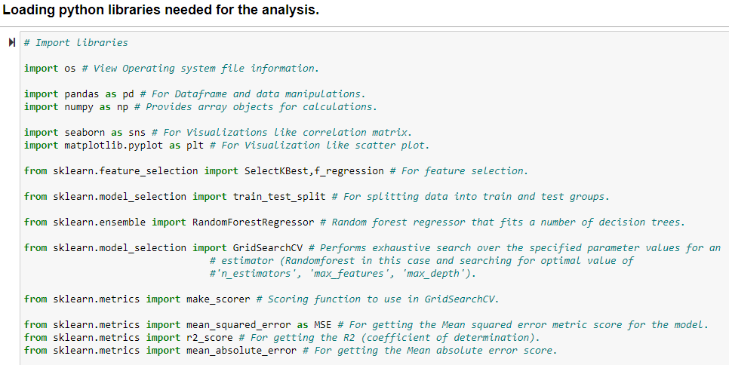
B3: The list of libraries and their usages for this analysis are shown on the table on the next page.

Slide 21
Library name | Usage
os | View Operating system file information.
pandas | For importing data into Dataframe and data manipulations.
numpy | It provides array objects for calculations.
seaborn | For Visualizations like correlation matrix.
matplotlib.pyplot | For Visualization like scatter plot.
sklearn.feature_selection import SelectKBest,f_classif | For feature selection.
sklearn.model_selection import train_test_split | For splitting data into train and test sets.
sklearn.ensemble import RandomForestRegressor | Random forest regressor that fits a number of decision trees.
sklearn.model_selection import GridSearchCV | Performs exhaustive search over the specified parameter values for an estimator (Randomforest in this case and searching for the optimal value of 'n_estimators', 'max_features', 'max_depth').
sklearn.metrics import accuracy_score | It provides an accuracy score for the model.
sklearn.metrics import make_scorer | Scoring function to use in GridSearchCV.
sklearn.metrics import mean_squared_error as MSE | For getting the Mean squared error metric score for the model.
sklearn.metrics import r2_score | For getting the R2 (coefficient of determination).
sklearn.metrics import mean_absolute_error | For getting the Mean absolute error score.

Slide 22
B3 Cont’d. Examples of R packages and libraries.
Package/Library Name | Usage
dplyr | For improving and simplifying the variable names
caret | For classification and regression training functions. Helps find and remove highly correlated variables. Will allow the use of the train () function. Also used for viewing the confusion matrix
ggplot2 | For creating graphical representations
E1071 | For supporting the Decision Trees and random forest models.
Ranger | For implementing decision tree and random forests models
RocR | For display and analyzing the ROC curves and AUC values.
varImp | To plot importance of features in the model
RandomForest | For creating models
Rpart | For running the DT algorithm. For train classification tree and for plotting the Tree and building Decision Tree model
base | For predicting and fitting the DT model
Party | For creating and visualizing decision trees.
DAAG | For Data Analysis and Graphics Data and Functions
pROC | For displaying and analyzing ROC Curves
tree | For filtering missing data from the model frame.

Slide 23
Part III: Data Preparation
C. Perform data preparation for the chosen data set by doing the following:
C1. Describe one data preprocessing goal relevant to the prediction method from part A1.
Data preprocessing is a term that covers a variety of operations data scientists will use to get the data in a form to be ready for analysis. Example: Removing white spaces, imputing missing data, scaling, etc.
You can use one-hot encoding to convert the categorical variables into dummy variables, which also takes care of the datatype for all the object datatypes variables.
Many machine learning models cannot work directly with categorical data. Therefore, you many need to convert such categorical data into a numeric form for the machine learning algorithm. Pandas' library provides get_dummies method to convert categorical features to dummy or indicator variables.

Slide 24

C2. Identify the initial data set variables that you will use to perform the analysis for the prediction question from part A1 and group each variable as continuous or categorical.
You can perform feature selection using SelectKBest to select the following variables for the random forest analysis.
Feature selection helps select the correct variables and eliminate those that do not help much with the prediction, thus improving a predictive model's efficiency and effectiveness.
K in SelectKBest is a value greater than 0 and lower or equal to the total number of features.
Note: In your write-up show the code to implement SelectKBest class.
Variable | Type
Bandwidth_GB_Year | Continuous
Churn_Yes | Categorical
DeviceProtection_Yes | Categorical
Options | Categorical
OnlineBackup_Yes | Categorical

Slide 25
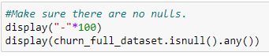
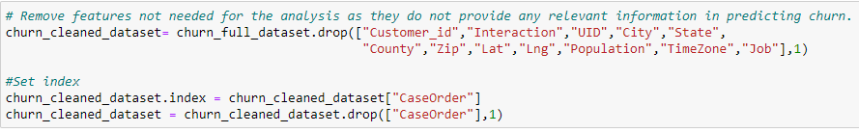
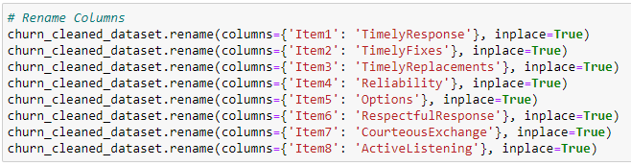
C3. Explain the steps used to prepare the data for the analysis. Identify the code segment for each step.
We loaded, cleaned, and explored the data. Here are the steps.
1. Look for null values and eliminate them. Let the evaluator know if you found any null values in the data.
2. Remove features not required for the analysis.
3. Rename the columns to give proper naming for the predictors.

Slide 26
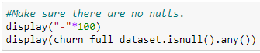
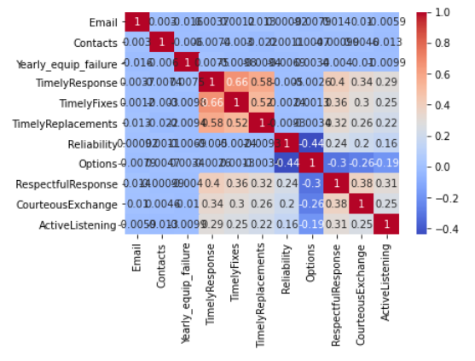
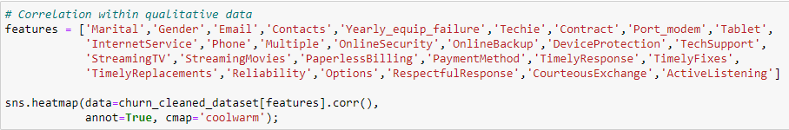
4. Address missing data and outliers- In our data, we did not find any missing data or outliers
5. Look for correlation in data. Correlated features will carry extra weight on the distance calculation than desired that could negatively impact the model. A heatmap can help show that correlation. It is a colorful graph that can visually show frequency or interaction using a range of colors.

Slide 27
Per observation, we see some close correlation between TimelyResponses, TimelyFixes, TimelyReplacements, RespectfulResponse, CourteousExchange, and ActiveListening.
6. Convert categorical variables into dummy variables, and this also takes care of datatype change to int for all the object datatypes variables. Paste your code here.
7. Variable/feature selection is important to understand which features are useful in predicting a target variable. This helps select the correct features and eliminate those that do not help much with the prediction, thus improving a predictive model's efficiency and effectiveness. You can use “SelectKBest” from scikit-learn to identify important features. Paste your code here.
C4. Provide a copy of the cleaned data set.

Slide 28
Part IV: Analysis
D. Perform the data analysis and report on the results by doing the following:
D1. Split the data into training and test data sets and provide the file(s).
You can use the train_test_split library from sklearn.model_selection to split the data into 80% training and 20% testing data sets.
The model is trained on the training data set.
The model is evaluated on the testing data set. This approach is also called hold-out validation.
This is to ensure the model has similar accuracy when predicting unseen data (new data sets that the model has not seen before during the training).

Slide 29
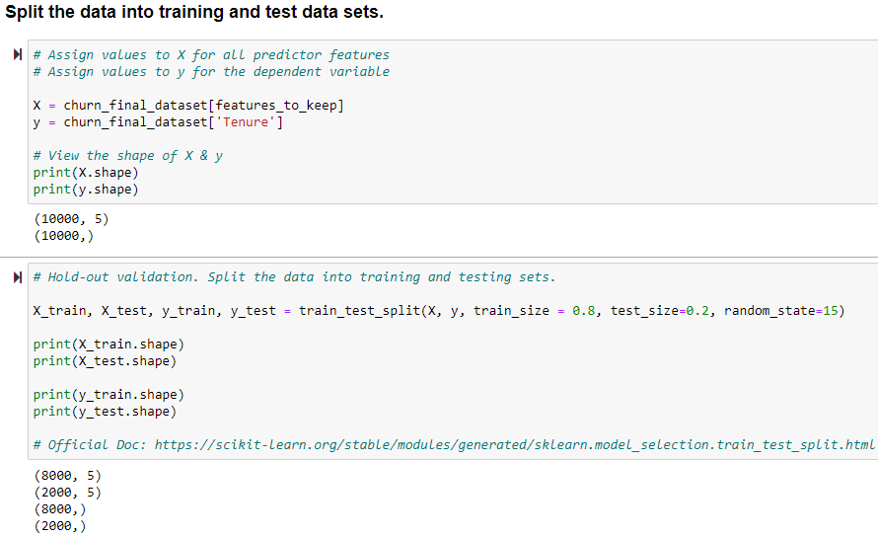
Code to split the data into training and testing sets

Slide 30
R Code to split the data
x_train, x_test, y_train, y_test = sklearn.model_selection.train_test_split(X, yrandom_state=0, train_size=0.8,test_size = 0.2)
Save the split data components into CSV files and they would be loaded into the assessment tool for D209 Task2
x_test.to_csv(r'x_test_file_t2.csv',index=False)
y_test.to_csv(r'y_test_file_t2.csv',index=False)
x_train.to_csv(r'x_train_file_t2.csv',index=False)
y_train.to_csv(r'y_train_file_t2.csv',index=False)

Slide 31
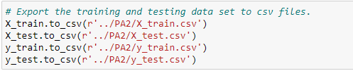
Code to export the training and testing data sets.
The exported files are available as:
Data set | File name
X_train | X_train.csv
X_test | X_test.csv
y_train | y_train.csv
y_test | y_test.csv

Slide 32
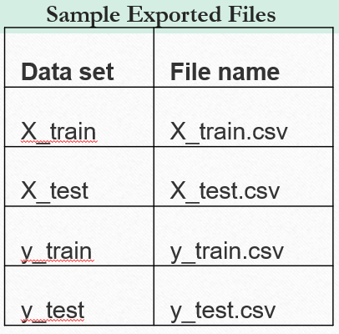
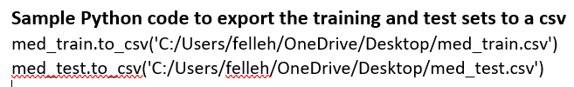
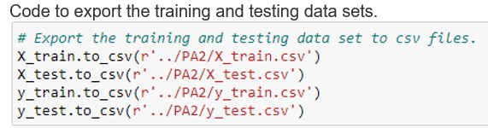
More Sample Codes to export the data:
You will write a code to export the training and testing data sets to a CSV file. Can use PA2 file format. PA2 is used by an application called STABCAL (Stability Calculation for Aqueous Systems). Can use the to_ csv( ) to save or export file to csv in python. For working CSV files in python, there is an inbuilt module called csv. See the link below:
https://www.geeksforgeeks.org/working-csv-files-python/

Slide 33
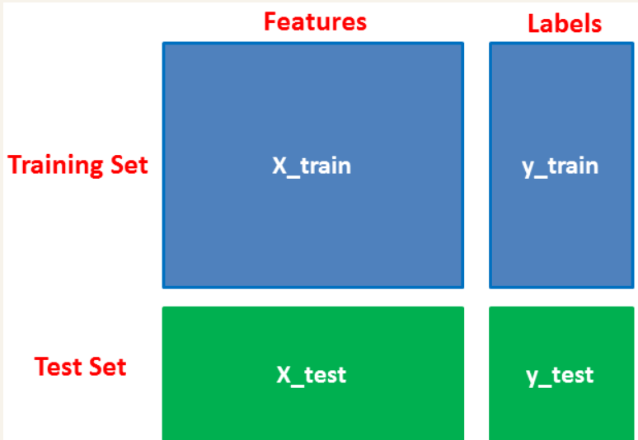
Why x-train, y-train, x-test, y-test?
First, you separate the columns into independent and dependent variables(or features and label). Then you split those variables into train and test sets.
If you need to work with independent and dependent variables in your analysis, you will first separate the columns into independent and dependent variables. Then you split those variables into train and test sets.
You can label the independent variable x-train and the dependent variable y-train for the training set;
and x-test, y-test for the test set. You will then end up with four files.

Slide 34
D2. Describe the analysis technique you used to appropriately analyze the data. Include screenshots of the intermediate calculations you performed.
Your analysis techniques will be DT, RF, or R(Lasso, Ridge). Describe and explain what it is and how you use it to analyze your data. Provide a detailed interpretation of each result with screenshots. That may cover:
Converting the categorical variables into dummy variables.
Splitting the data into 80% training set and 20% testing set.
Building the model.
Instantiating the DT or RandomForestRegressor object.
Identify optional values for parameters using hyperparameter tuning.
Instantiating the GridSearchCV() object.
Performing GridSearchCV and training the model
Checking and printing best parameters used.
Checking the best score for the top-performing model.
Printing MSE, RMSE, and R-Squared - scores
Performing predictions on the test data and print test accuracy score.
Determining which features were the most predictive according to Decision Tree or Random Forests Regressor.

Slide 35
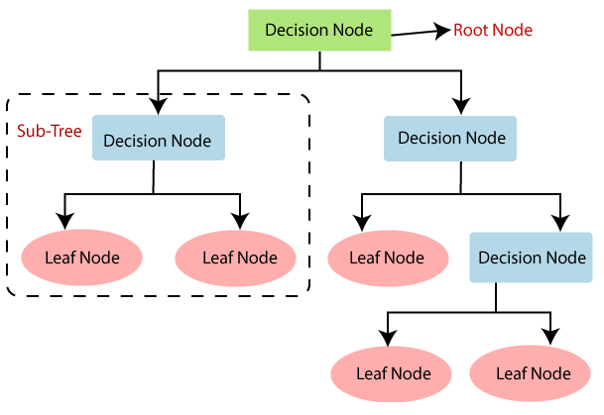
D2. Cont’d
If you used a decision tree, you might want to explain it. DT is a non-parametric supervised learning method that builds the models in a tree structure. It breaks down a data set into smaller and smaller subsets while at the same time an associated decision tree is incrementally developed. The result is a tree with decision nodes and leaf nodes. A decision node has two or more branches. Leaf node represents a classification or decision. The topmost decision node in a tree corresponds to the best predictor called the root node. Decision trees can handle both categorical and numerical data.

Slide 36
For Random Forests: RFs are an ensemble learning method for classification and regression problems. It constructs multiple decision trees at the training time and outputs the mean of the predictions for regression
Each of the trees makes its own individual prediction. These predictions are then averaged to produce a single result
A prediction from the Random Forest Regressor is an average of the trees' predictions in the forest (Medium, 2018; Datacamp, n.d; Neptune, 2021; Scikit-learn, 2020).
You can use the Scikit-learn library of Python to build the random forest model.

Slide 37
You may convert the categorical variables into dummy variables as required for the random forest algorithm to use the data for creating the model. See sample code below:
Splitting the data into 80% training set and 20% testing set. Fit the model on the training data set and evaluate its scores on the testing dataset.
Perform hyperparameter tuning and identify the best values using GridSearchCV() class Hyperparameter tuning tries multiple values for the parameters, fits all of them separately, sees how well they perform, and chooses the best value for each parameter.

Slide 38
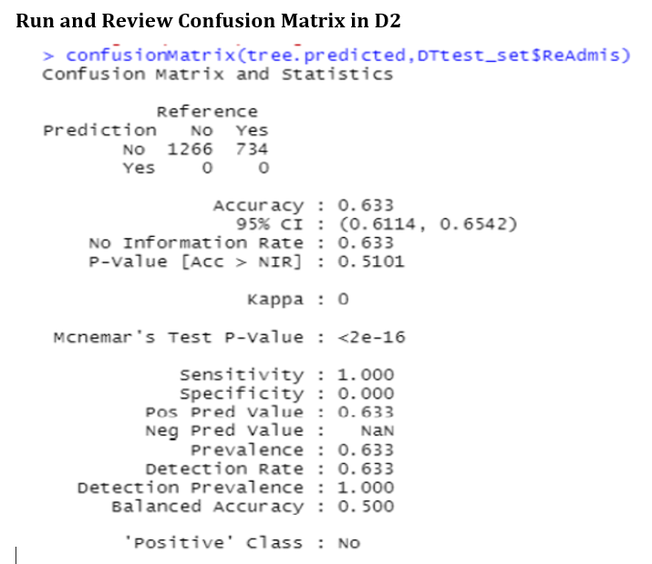

Slide 39
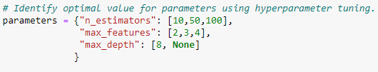
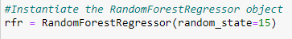
Providing values:
For n_estimators you may provide values say 10, 50, and 100.
For max_features you may provide values, say 2, 3, and 4.
For max_depth values 8 and None.
None indicates nodes are expanded until all leaves are pure or until all the leaves contain less than min_samples_split samples.
Instantiate the RandomForestRegressor object
MSE: You can use mean squared error (MSE) as a scoring function to evaluate the model e.g.
scorer = make_scorer(MSE)
You can use GridSearchCV, to performs k-folds cross-validations and hyperparameter tuning.

Slide 40
Model Evaluation is an integral part of the model development process that helps to find the best model that represents our data and how well the chosen model will work in the future.
Two Methods in Data Science: Hold-Out and Cross-Validation.
Hold-Out randomly divides the dataset into three subsets:
Training set is used to build predictive models.
Validation set is used to assess the performance of the model built in the training phase. It provides a test platform for fine-tuning the model's parameters and selecting the best-performing model. Not all modeling algorithms need a validation set.
Test set is used to assess the likely future performance of a model. If a model fit to the training set much better than it fits the test set, overfitting is probably the cause.
Cross-Validation – used when data is limited
K-fold cross-validation divides the data into k subsets of equal size.
We build models k times, each time leaving out one of the subsets from training and use it as the test set.
If k equals the sample size, this is called "leave-one-out".

Slide 41
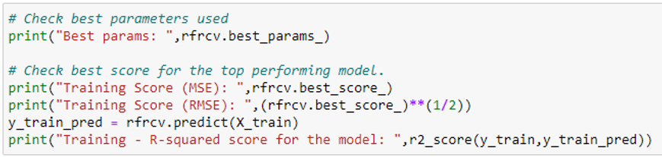
The fit method is then called to run the GridSearchCV object, which trains and evaluates various combinations of models for different parameter values. Example: rfrcv.fit(x-train, y_train)
You can use best_params to view the best model parameters. And best_score provides the best model accuracy score.
The output will show:
The MSE score on the training data set
The root mean squared error (RMSE) score on the training data set.
The r-squared score on the training data set.

Slide 42
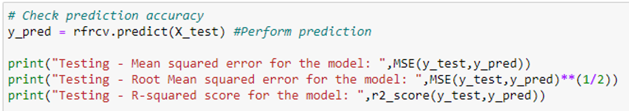
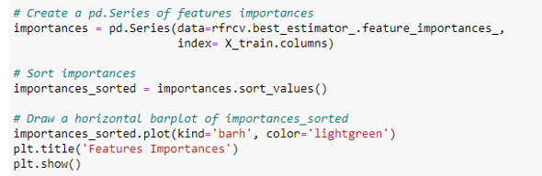
You can perform predictions on the test data and printing test accuracy scores. Check prediction accuracy
Now, you can determine which features were the most predictive according to the random forests regressor. See sample code below:

Slide 43
D3. Provide the code used to perform the prediction analysis from part D2. Copy and paste the codes in your paper for the following: Include others DT RG
Converting the categorical variables into dummy variables if applicable to you.
Splitting the data into 80% training set and 20% testing set.
Creating or building the model.
Plotting and printing DT.
Selecting the classifier and fitting the model.
Instantiate the RandomForestRegressor or DecisionTreeClassifier object.
Identify optional value for parameters using hyperparameter tuning.
Instantiate the GridSearchCV() object
Perform GridSearchCV and train the model
Check and print best parameters used.
Check best score for the top performing model.
Print MSE, RMSE, and R-Squared
Perform predictions on the test data and print test accuracy score.
Determine which features were the most predictive according to Random Forests Regressor.

Slide 44
Part V: Data Summary and Implications
E. Summarize your data analysis by doing the following:
E1. Explain the accuracy and the mean squared error (MSE) of your prediction model.
You can provide as follows:
Mean square error (MSE) score
Root Mean Squared Error (RMSE)
R Squared (R2) - The coefficient of determination
MSE Is the sum of squares differences between the predicted values and the actual values. It determines how good the estimate is based on the algorithm analysis(Grace-Martin, 2020).
The predicted value is based on some equation and tells what you will expect as an average, but the result you get might differ from this prediction which could be a slight error from the estimated value. This difference is called MSE. The lower the value for MSE, the more accurately a model is able to predict values (Zach, 2020, April 16).
Both RMSE and MSE can show if the degree of error is significant in the model.

Slide 45
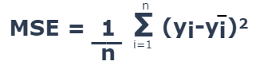
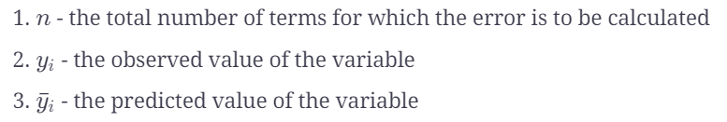
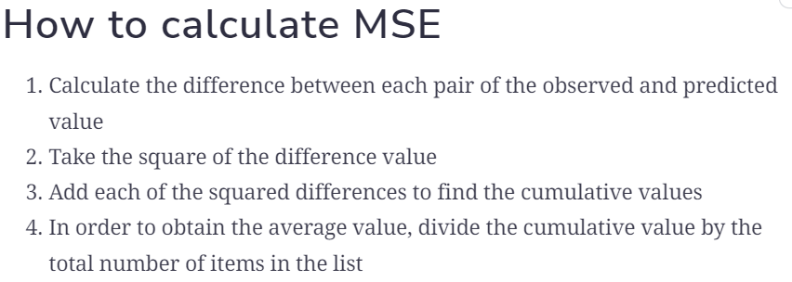
Formula

Slide 46
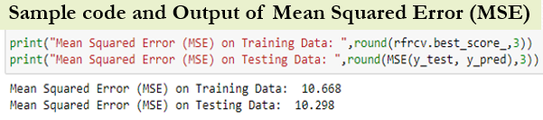
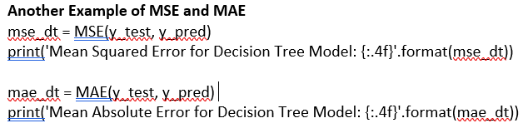
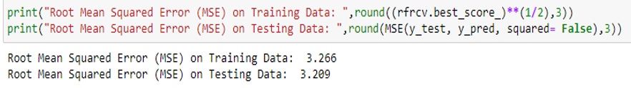
Random forest regressor uses a decision tree regressor. A decision tree regressor uses mean squared error (MSE) to split a node into two or more sub-nodes. This decision of splitting affects a tree's accuracy. The decision tree regressor picks a variable and the value to split on such that the two groups are as different from each other as possible. A weighted average of the groups' mean squared error is then taken (GDCoder, 2020).
Root Mean Squared Error (RMSE) -
This is the square root of the MSE. It is a frequently used measure of the difference between values predicted by a model and the values actually observed. This is defined as the square root of the average squared distance between the actual score and the predicted score (Medium, 2020). Sample code and output of RMSE below:

Slide 47
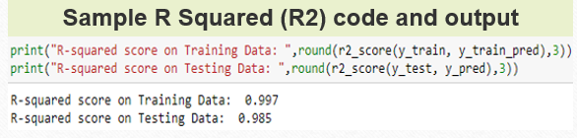
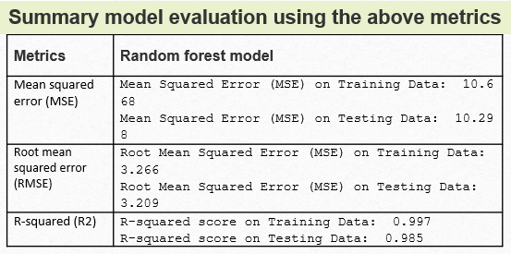
R Squared (R2) - The coefficient of determination
This metric measures the relationship between the residual sum of squares (RSS) and the total sum of squares (TSS). The RSS is computed as the ground truth minus the predicted ground truth. This metric tells how well a model fits the data. It ranges between 0 and 1. Higher the R-squared, the better the model fits the data.

Slide 48
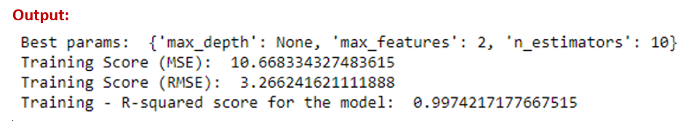
Sample Code 1 in Python:
# Given table results with the following columns:
results = pd.DataFrame({'Actual y':y_test, 'Predicted y':y_pred}) ## Actual y, Predicted y, error, squared error
results['error'] = results['Actual y'] - results['Predicted y’] ## error = actual y - predicted y
results['squared error'] = np.square(results['error’]) ## squared error = error ** 2
results
results['squared error'].mean()
--------------------------------------------------------------------------------------------------------------------------------
Sample Code 2 in Python:
print(“Best params: “, rfrcv.best_params_) ## check best parameters used
Print(“Training Score (MSE): “,rfrcv.best_score_) ## check best score for the top performing model.
Print((“Training Score (RMSE): “,(rfrcv.best_score_)**(1/2))
y_train-pred = rfrcv.predict(x_train)
print(“Training - R-squared score for the model: “,r2_score(y_train, y_train_pred))

Slide 49
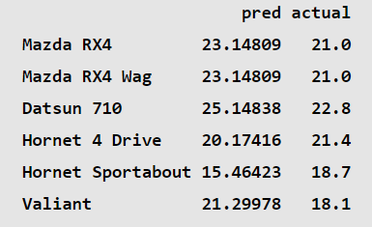
How to Calculate MSE in R
Two methods to calculate the MSE of a regression model in R.
Sample Code 1 in R: Calculating the MSE of a fitted regression model
data(mtcars) ## #load mtcars dataset
model <- lm(mpg~disp+hp, data=mtcars) ## fit regression model
model_summ <-summary(model) ## get model summary
mean(model_summ$residuals^2)
Output (MSE): 8.85917
Sample Code 2 in R: Calculating the MSE from a list of Predicted and Actual Values
R Code
Output
data <- data.frame(pred = predict(model), actual = mtcars$mpg) ##create data frame with a column
of actual and predicted values
head(data) ## view first six lines of data

Slide 50
mean((data$actual - data$pred)^2) ## calculate MSE
Output (MSE) = 8.85917
Predicted probabilities on the test set including RMSE:
predictions_test <- predict(final_model,
demo_test) %>% bind_cols(demo_test)
str(predictions_test)
demo_test <- demo_test %>% mutate(predictions_test)
demo_test$residuals < as.numeric(demo_test$ReAdmis) -
as.numeric(demo_test$.pred_class)
str(demo_test)
rmse_test <- sqrt(mean(demo_test$residuals^2))
rmse_test
#compare the results
rmse and rmse_test
Sample Code Example 1 in R: Calculating the RMSE from a list of Predicted and Actual Values
Predicted probabilities on the training set including RMSE:
predictions <- predict(final_model, demo_train) %>%
bind_cols(demo_train)
str(predictions)
demo_train <- demo_train %>% mutate(predictions)
demo_train$residuals <- as.numeric(demo_train$ReAdmis) -
as.numeric(demo_train$.pred_class)
str(demo_train)
rmse <- sqrt(mean(demo_train$residuals^2))
rmse
https://www.statology.org/author/admin/

Slide 51
E2. Discuss the results and implications of your prediction analysis.
We used Random forest machine learning model for this analysis. The random forest model we developed has a testing r-squared score of 98.5%. This is a good score.
The root mean squared error for this model is 3.209.
We have used the SelectKBest approach of feature selection for this model.
We have used hyperparameter tuning to find the optimal value for n_estimators, max_features, and max_depth. Based on GridSearchCV() the best model provided the optimal value for n_estimators = 10, max_features = 2 and max_depth = None.
The model accuracy could be further improved by performing hyperparameter tuning on additional parameters and by using more labeled data to train the model.

Slide 52
E3. Discuss one limitation of your data analysis.
Random forest is a popular machine learning model, and its ability to predict non-linear data makes it more powerful. However, a random forest cannot extrapolate. It can only make predictions that are an average of previously observed labels. This could be a problem when the training and prediction inputs differ in their range. This is called covariate shift, and it is difficult for most models to handle, especially for Random Forest, because it cannot extrapolate. In such situations, other algorithms could be used like support vector machine (SVM) (Medium, 2018).

Slide 53
E4. Recommend a course of action for the real-world organizational situation from part A1 based on your results and implications discussed in part E2.
• Based on this analysis report and the model's accuracy score, the company can use this random forest model to predict the customers' tenure.
• The model could be further improved by performing hyperparameter tuning on additional parameters and by using more labeled data to train the model.
• Based on the exploratory data analysis, customers with higher Bandwidth_GB_Year have a higher tenure. Further analysis should be done on customers with less Bandwidth_GB_Year to see how their usage could be increased and further increase the customer's tenure.
• Customers having OnlineBackup have shorter tenure compared to customers not having OnlineBackup. The company should investigate this as there is a possibility that customers are not happy with this feature.
Note: Tenure and Bandwidth are continuous variables. Therefore, the histograms of these two variables do not show "binomial graphs".

Slide 54
Part VI: Demonstration
F. Provide a Panopto video recording that includes a demonstration of the functionality of the code used for the analysis and a summary of the programming environment.
Note: The audiovisual recording should feature you visibly presenting the material (i.e., not in voiceover or embedded video) and should simultaneously capture both you and your multimedia presentation.
See Requirement page for details on how to access, use, and submit your Panopto video recording.
G. Record the web sources used to acquire data or segments of third-party code to support the analysis. Ensure the web sources are reliable.
H. Acknowledge sources, using in-text citations and references, for content that is quoted, paraphrased, or summarized.
If the evaluation commented that the reference list citations are presented with limited bibliographical detail. See what it means on the next slide.

Slide 55
The lack of bibliographical details means that the reference (s) even though listed did not have the minimal set of elements needed to identify that source. For a Journal article, you might need: name of the author(s), year of publication, title, journal name, volume, issue number, pagination, URL, etc.
Journal Example:
Debbie, T., Timothy, K. J., & Mark, F. N. (2007). IT project risks: The project management professional perspective. The Journal of Computer Information Systems, 1-5.
Web Example:
Brownlee, J. (2018). Metrics to evaluate machine learning algorithms in Python. Retrieved 01/03/2022 from https://machinelearningmastery.com/metrics-evaluate-machine-learning-algorithms-python
I. Demonstrate professional communication in the content and presentation of your submission.

Slide 56
FAQ
Q1. What is the difference between correlation and regression:
The difference is that while correlation measures the strength of an association between two variables, regression quantifies the nature of the relationship.
from sklearn.ensemble import RandomForestRegressor
# Instantiae Random Random Forest Regressor model
rfr = RandomForestRegressor(n_estimators=500, random_state=1)
# Fit model to dataframe
rfr.fit(X_train, y_train)
If you choose to work with the classifier, check this link out:
https://www.datacamp.com/community/tutorials/random-forests-classifier-python
If you choose to fix the array, this link might be helpful.
https://stackoverflow.com/questions/45554008/error-in-python-script-expected-2d-array-got-1d-array-instead

Slide 57
Q2. Why requiring accuracy and MSE in predictive model?
Accuracy, with a capital A, is a metric used to evaluate classification models, but to measure a predictive model's accuracy, with a lower case ‘a’, is done with MSE, RMSE and R-squared. The smaller the error, the better the accuracy of prediction.
Elaboration on ‘accuracy’ which is what E1 requires.
Using continuous or categorical variable in an analysis does not determine the need for model validation. Most models created needed validation for accuracy and precision. That’s just to know if the model is performing well. In supervised learning you must split the dataset into training and test sets. The test set is to be used to validate the model performance (accuracy and precision). Regression, ARIMA, Neural Networks, etc., are all predictive models and they are validated for accuracy and precision.
The difference is that the metrics and approach for testing model accuracy in classification is not the same as in predictive models. For example, if you are working on a classification problem, the best score is 100% accuracy. If you are working on a regression problem, the best score is 0.0 error.

Slide 58
In Task 2, the MSE, RMSE, and R-Squared are evaluation metrics for testing model accuracy. After splitting the data, you can check the best score for the top performing model, you can check for training accuracy and print the score. After performing predictions, you can check for prediction accuracy. If the model accuracy needs improvement, you can perform hyperparameter tuning on additional parameters or use more labeled data to train the model.
Q3. Explain MSE, MAE, RMSE, R-Squared.
Mean squared error (MSE): Is the sum of squares differences between the predicted values and the actual values. The predicted value is based on some equation and tells what you will expect as an average, but the result you get might differ from this prediction which might be a slight error from the estimated value. This difference is called MSE.
A decision tree regressor uses mean squared error (MSE) to split a node into two or more sub-nodes. The decision tree regressor picks a variable and the value to split on such that the two groups are as different from each other as possible. A weighted average of the groups' mean squared error is then taken (GDCoder, 2020).

Slide 59
Root Mean Squared Error (RMSE): This is the square root of the MSE. It is a frequently used measure of the difference between values predicted by a model and the values actually observed. This is defined as the square root of the average squared distance between the actual score and the predicted score (Medium, 2020).
R Squared (R2) - The coefficient of determination measures the relationship between the residual sum of squares (RSS) and the total sum of squares (TSS). The RSS is computed as the ground truth minus the predicted ground truth. This metric tells how well a model fits the data. It ranges between 0 and 1. Higher the R-squared, the better the model fits the data.
Mean absolute error (MAE) is a measure of errors between paired observations expressing the same phenomenon. It measures the average magnitude of the errors in a set of forecasts, without considering their direction. It measures accuracy for continuous variables.

Slide 60
Q4. If your MSE output was “NA”
If your MSE output was “NA” it was an indication that your model is not reliable since it could not be calculated. It may be due to the way you set up your model and the types of variables used. You may need to convert your categorical variables to numeric. Your output must be a continuous variable.
To calculate MSE, First import the library/package: sklearn.metrics import mean_squared_error as MSE.
Quick Video on how to calculate MSE in Python:
https://www.youtube.com/watch?v=tJpzKILW-Kg
Calculating Mean Squared Error in Python:
https://www.educative.io/answers/calculating-mean-squared-error-in-python
Formula

Slide 61
Q2. What are the classification metrics to evaluate Machine Learning Algorithms in Python?
Classification Metrics to evaluate Machine Learning Algorithms in Python are:
Classification Accuracy.
Log Loss.
Area Under ROC Curve.
Confusion Matrix.
Classification Report.
Q3. What is AUC, ROC, Accuracy Score?
AUC and ROC are performance metrics for binary classification problems.
The AUC represents a model’s ability to discriminate between positive and negative classes. An area of 1.0 represents a model that made all predictions perfectly. An area of 0.5 represents a model as good as random.
A ROC Curve is a plot of the true positive rate and the false positive rate for a given set of probability predictions at different thresholds used to map the probabilities to class labels. The area under the curve is then the approximate integral under the ROC Curve.
Brownlee, J. (2018). Metrics to evaluate machine learning algorithms in Python. Retrieved 10/20/2021 from
https://machinelearningmastery.com/metrics-evaluate-machine-learning-algorithms-python
Brownlee, J. (2018). How to Use ROC Curves and Precision-Recall Curves for Classification in Python. Retrieved from
https://machinelearningmastery.com/roc-curves-and-precision-recall-curves-for- classification-in-python/

Slide 62
Accuracy score - Is correct classifications over total samples.
Precision score – Percentage of correct classifications per label. The number of true positives divided by the number of true and false positives.
Recall score –The number of true positives divided by the number of true positives plus the number of false negatives.
F1_score - Average of Precision and Recall scores.
Q4. What is a baseline predictive model?
A baseline is a simple and well understood procedure for making predictions on your predictive modeling problem. The results for the baseline model provide the point from which the skill of all other models trained on your data can be evaluated.
Three examples of baseline models include:
Predict the mean outcome value for a regression problem.
Predict the mode outcome value for a classification problem.
Predict the input as the output (called persistence) for a univariate time series forecasting problem.

Slide 63
Huber loss is both MSE and MAE. It is quadratic(MSE) when the error is small else MAE.
CODES:
# Check best parameters used
print("Best params: ",rfrcv.best_params_)
# Check best score for the top performing model.
print("Training Score (MSE): ",rfrcv.best_score_)
print("Training Score (RMSE): ",(rfrcv.best_score_)**(1/2))
y_train_pred = rfrcv.predict(X_train)
print("Training - R-squared score for the model: ",r2_score(y_train,y_train_pred))
Here is the output approximated:
Best params: {'max_depth': None, 'max_features': 2, 'n_estimators': 10}
Training Score (MSE): 10.7
Training Score (RMSE): 3.3
Training - R-squared: 0.99
# Check prediction accuracy
y_pred = rfrcv.predict(X_test) #Perform prediction
print("Testing - Mean squared error for the model: ",MSE(y_test,y_pred))
print("Testing - Root Mean squared error for the model: ",MSE(y_test,y_pred)**(1/2))
print("Testing - R-squared score for the model: ",r2_score(y_test,y_pred))
Here is the output approximated:
Testing - Mean squared error for the model: 10.3.
Testing - Root Mean squared error for the model: 3.2.
Testing - R-squared score for the model: 0. 98.

Slide 64
Q. Is it required to do hyperparameter twice or more?
Hyperparameter helps you identify the optimal value for parameters. It also helps improve model accuracy further if performed on additional parameters. It is not required to do more than once, but you could do more than once if the first one did not give you the desired result or you need to improve your model performance even further.
Analytics Vidhya (April 2021). Evaluating Machine Learning Models using Hyperparameter Tuning.
https://www.analyticsvidhya.com/blog/2021/04/evaluating-machine-learning-models-hyperparameter-tuning/

Slide 65
REFRENCE SECTION
TASK 2

Slide 66
Python - Decision Tree Analysis
Datacamp. (n.d). Decision-Tree for Classification. https://campus.datacamp.com/courses/machine-learning-with-tree-based-models-in-python
GDCoder. (2020, Feb 5). Decision tree regressor explained in depth. https://gdcoder.com/decision-tree-regressor-explained-in-depth/
Medium. (2018, Sep 26). Decision trees explained. https://towardsdatascience.com/decision-trees-explained-3ec41632ceb6
Medium. (2020, Jun 18). What is one-hot encoding and how to use pandas get_dummies function. https://towardsdatascience.com/what-is-one-hot-encoding-and-how-to-use-pandas-get-dummies-function-922eb9bd4970.
Navlani, A. (2018, December 28). Attention Required! | Cloudflare. Datacamp. https://www.datacamp.com/community/tutorials/decision-tree-classification-python
Sehra, C. (2020, November 30). Decision Trees Explained Easily - Chirag Sehra. Medium. https://chiragsehra42.medium.com/decision-trees-explained-easily-28f23241248

Slide 67
Python - Decision Tree Analysis Cont’d
K, D. (2021, April 10). Implementing Regression Using a Decision Tree and Scikit-Learn. Medium. https://heartbeat.fritz.ai/implementing-regression-using-a-decision-tree-and-scikit-learn-ac98552b43d7

Slide 68
Python – Random Forests
Datacamp. (n.d). Visualizing features importances. https://campus.datacamp.com/courses/machine-learning-with-tree-based-models-in-python/bagging-and-random-forests?ex=10
Medium. (2020, Aug 4). How to evaluate the performance of a machine learning model. https://towardsdatascience.com/how-to-evaluate-machine-learning-model-performance-in-python-135b4ae27f7e
Neptune. (2021, Feb 25). Random Forest Regression: When Does It Fail and Why?. https://neptune.ai/blog/random-forest-regression-when-does-it-fail-and-why
Scikit-learn. (2020). Random forest regressor. https://scikit-learn.org/stable/modules/generated/sklearn.ensemble.RandomForestRegressor.html
StackExchange. (n.d). Random forest assumptions. https://stats.stackexchange.com/questions/59124/random-forest-assumptions
WGU. (n.d). Data files and associated dictionary files. https://access.wgu.edu/ASP3/aap/content/g9rke9s0rlc9ejd92md0.html

Slide 69
Python - Advanced Regression (lasso or ridge)
Grace-Martin, K. (2020, November 2). Assessing the Fit of Regression Models. The Analysis Factor. https://www.theanalysisfactor.com/assessing-the-fit-of-regression-models/
https://scikit-learn.org/stable/modules/generated/sklearn.metrics.roc_auc_score.html
Class and function reference of scikit-learn.
https://scikit-learn.org/stable/modules/classes.html#module-sklearn.metrics

Slide 70
R - Decision Tree Analysis
Grace-Martin, K. (2020, November 2). Assessing the Fit of Regression Models. The Analysis Factor. https://www.theanalysisfactor.com/assessing-the-fit-of-regression-models/
Data Science Show. (2017). Decision Tree Analysis in R Example Tutorial. Decision Tree Analysis in R Example Tutorial
K, D. (2021, April 10). Implementing Regression Using a Decision Tree and Scikit-Learn. Medium. https://heartbeat.fritz.ai/implementing-regression-using-a-decision-tree-and-scikit-learn-ac98552b43d7
Johnson, D. (2022). Decision Tree in R: Classification Tree & Code in R with Example. https://www.guru99.com/r-decision-trees.html Ketha, R. (2020). How to Split Data into Training and Testing Sets in R Studio. https://youtu.be/pDgTMl0Ed0Q
Navlani, A. (2018, December 28). Attention Required! | Cloudflare. Datacamp. https://www.datacamp.com/community/tutorials/decision-tree-classification-python
Sehra, C. (2020, November 30). Decision Trees Explained Easily - Chirag Sehra. Medium. https://chiragsehra42.medium.com/decision-trees-explained-easily-28f23241248

Slide 71
R – Random Forests
https://www.simplilearn.com/tutorials/data-science-tutorial/random-forest-in-r
https://www.analyticsvidhya.com/blog/2021/06/understanding-random-forest
StatQuest: Random Forests Part 1 - Building, Using and Evaluating – YouTube
https://www.r-bloggers.com/2017/07/random-forests-in-r/
https://www.section.io/engineering-education/introduction-to-random-forest-in-machinelearning/#:~:text=The%20(random%20forest)%20algorithm%20establishes,the%20precision %20of%20the%20outcome.
https://www.edureka.co/blog/random-forest-classifier/

Slide 72
R- Advanced Regression (lasso or ridge)
Linear Models. (2021). Scikit-Learn. https://scikitlearn.org/stable/modules/linear_model.html#lasso
Frost, J. (2021, November 14). Mean Squared Error (MSE). Statistics By Jim. https://statisticsbyjim.com/regression/mean-squared-error-mse/
Z. (2021, May 10). How to Interpret Root Mean Square Error (RMSE). Statology. https://www.statology.org/how-to-interpret-rmse/
Landup, D. (2021, May 14). Rotate Tick Labels in Matplotlib. Stack Abuse. https://stackabuse.com/rotate-axis-labels-in-matplotlib/ 1.7

